Slide 1
Chapter 12: User Interface Design

Slide 2
Key Takeaway Points
User interface design is concerned with the design of the look and feel of the user interfaces.
The design for change, separation of concerns, information-hiding, high-cohesion, low-coupling, and keep-it-simple-and-stupid software design principles should be applied during user interface design.
12-<number>

Slide 3
UI Design in the Methodology Context
Business goals
& needs
Current situation
Use case-iteration allocation matrix
Accommodating
Requirements Change
Customer
feedback
Acquiring
Requirements
Iteration use cases
Domain Modeling
Preliminary requirements
Domain model
Domain model
Deriving Use Cases
from Requirements
Actor-System Interaction Modeling & UI Design
Abstract & high level use cases, use case diagrams
Expanded use cases & UI design
Allocating Use Cases & Subsystems
to Iterations
Behavior Modeling &
Responsibility Assignment
Behavior models
Use case-iteration allocation matrix
Deriving Design Class
Diagram
Producing an Architecture Design
Design class diagram
Software architecture
Test Driven Development, Integration, & Deployment
(a) Planning Phase
(b) Iterative Phase – activities during each iteration
control flow
data flow
control flow & data flow
12-<number>

Slide 4
User Interface Design Activities
Layout design for windows and dialog boxes.
Design of interaction behavior.
Design of information presentation schemes.
Design of online support.
12-<number>

Slide 5
Importance of User Interface Design
The user interface is the sole communication channel between the user and the system.
Users’ feeling about the interface greatly influences the acceptance of the system and success of the project.
User-friendly interfaces may improve an organization’s productivity and work quality, and reduce operating costs.
12-<number>

Slide 6
Graphical User Interface Widgets
Container widgets
  window, dialog box, scroll pane, tabbed pane, and layered pane, and others.
Input, output and information presentation widgets
  text-oriented I/O widgets, selection-oriented input widgets, featured widgets
12-<number>

Slide 7
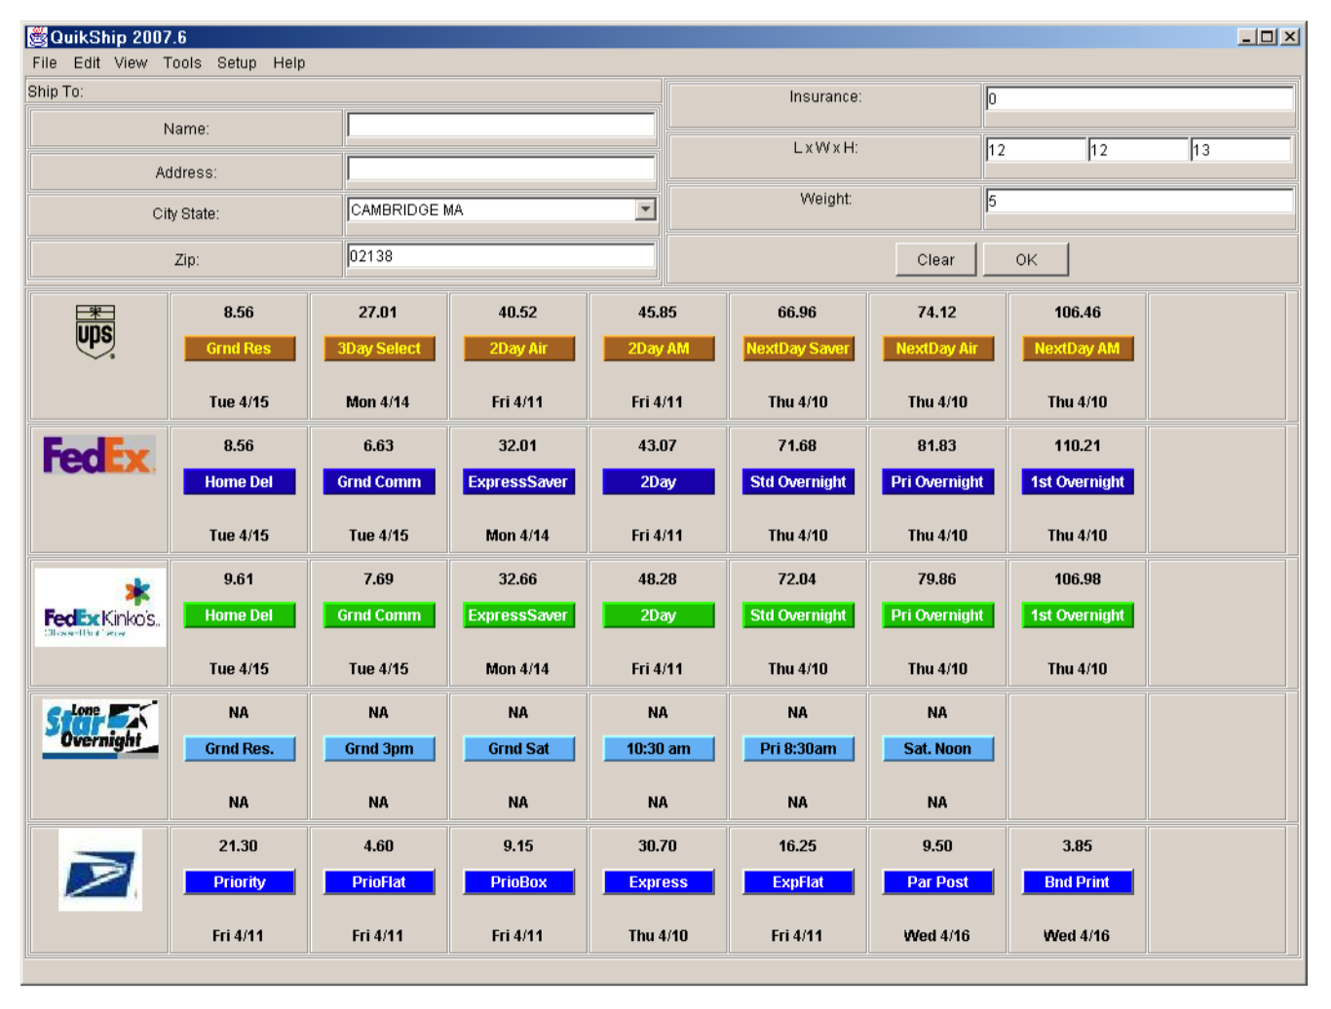
A shipping software that simplifies user operation
12-<number>

Slide 8
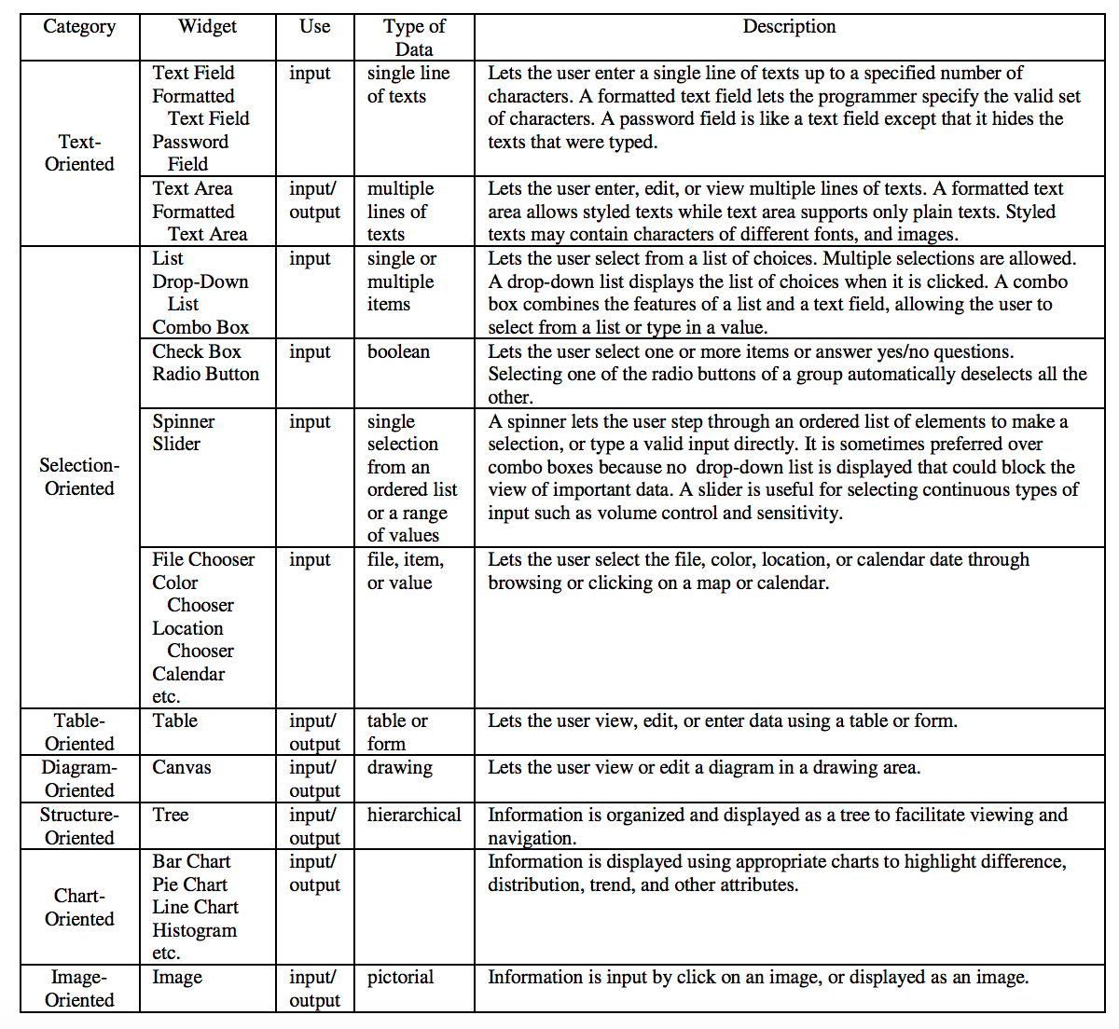
Widgets for user input and result display
12-<number>

Slide 9
Guidelines for using GUI widgets
Minimize the number of windows and dialog boxes that need to be opened to complete a business task while keeping the user interface easy to understand and use.
Use selection input whenever possible and appropriate to reduce human error.
Properly partition a long list into a hierarchy of shorter lists to facilitate selection.
  Apply abstraction when the information to be displayed is of the same kind.
  Apply classification when the information to be displayed is of different kinds or belongs to different categories.
12-<number>

Slide 10



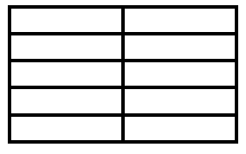

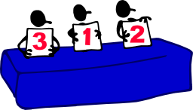

User Interface Design Process
(2) Produce a draft design of windows and dialogs
(3) Specify interaction
behavior
  (4) Implement a prototype if desired
Actor-System Interaction Modeling
(1) Identify major
system displays
Expanded Use Cases
(5) Evaluate UI design with users
12-<number>

Slide 11
Case Study:
User Interface Design for a Diagram Editor
The state diagram editor shall allow a user to edit a new diagram or an existing diagram. The editor shall allow the user to add, delete, and edit states and transitions as well as undo and redo these operations. The editor shall allow the user to perform other editing operations including “save” and “save as” a diagram.
12-<number>

Slide 12
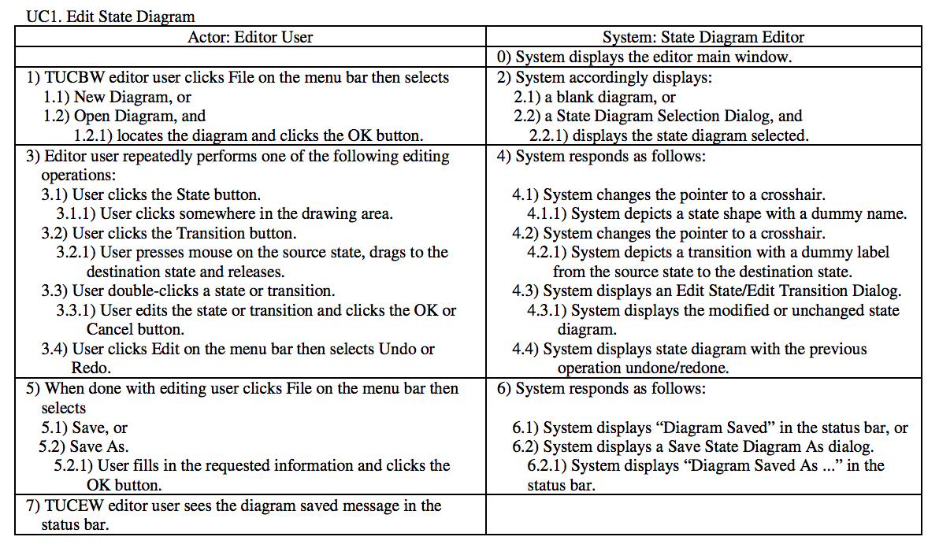
UC1: Edit State Diagram
12-<number>

Slide 13
Rules to identify major system displays
Examine the steps in the right column of each expanded use case. A major system display is identified if:
  The step displays system processing result, in this case, the displayed information is also identified, OR
  The step requests the user to supply input (text, selection, …)
Examine the steps in the left column of each expanded use case to identify user input and user actions associated with each system display.
12-<number>

Slide 14
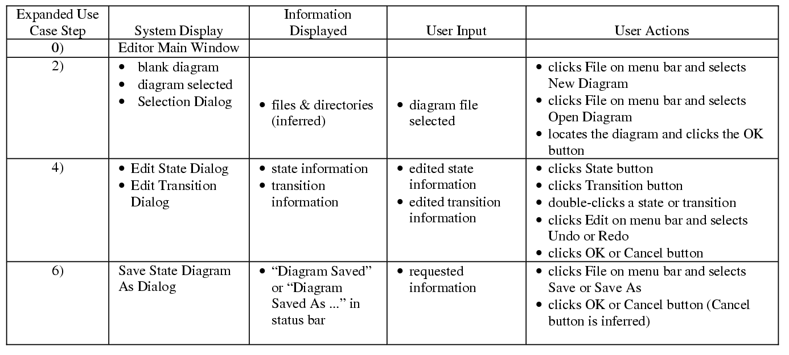
Edit State Diagram System Displays
12-<number>

Slide 15
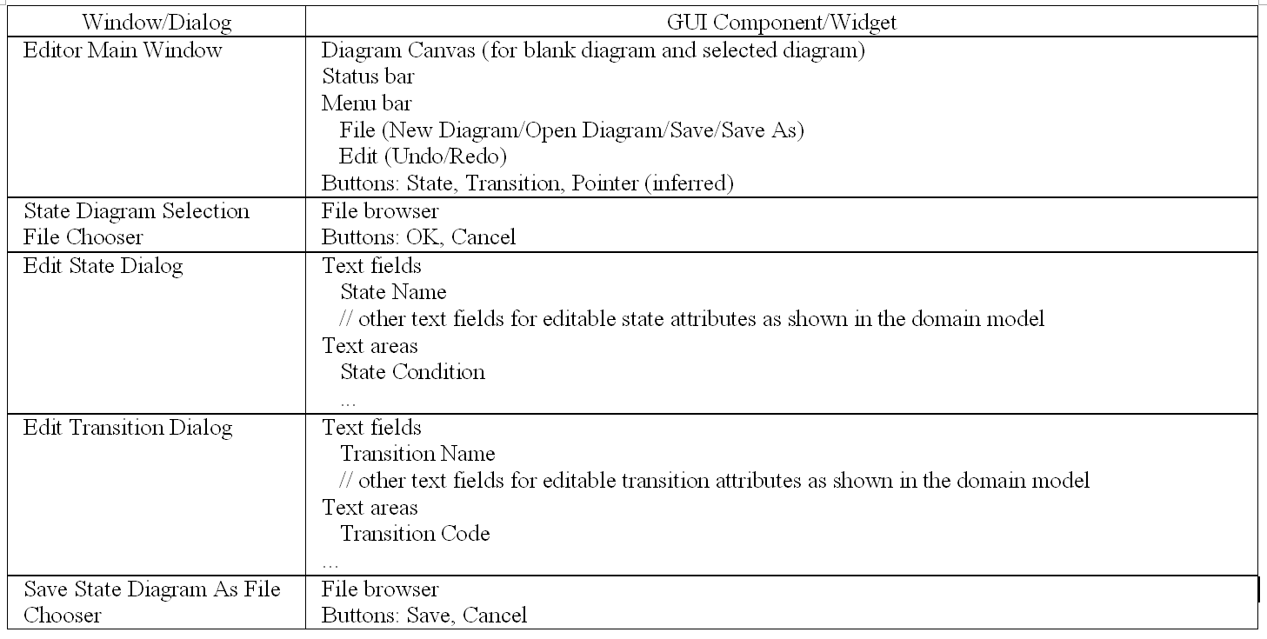
Windows, Dialogs and Widgets
12-<number>

Slide 16
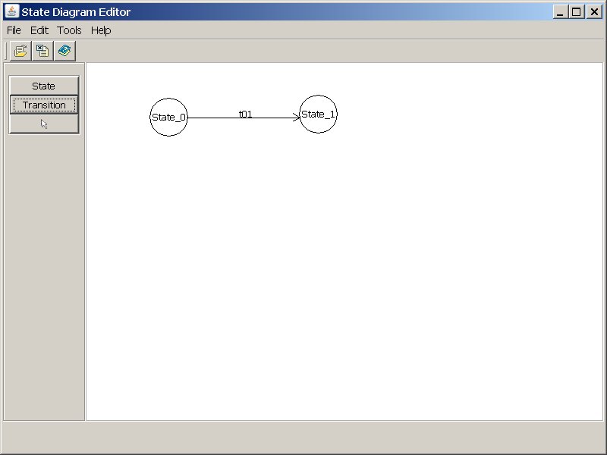
Layout Design of State Diagram Editor: main window
12-<number>

Slide 17
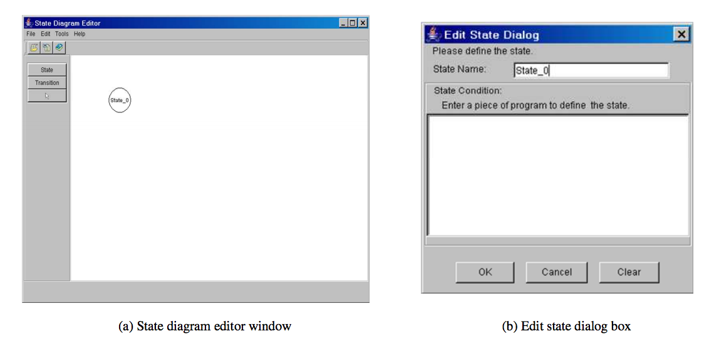
Layout Design of State Diagram Editor: a dialog for editing a state
12-<number>

Slide 18
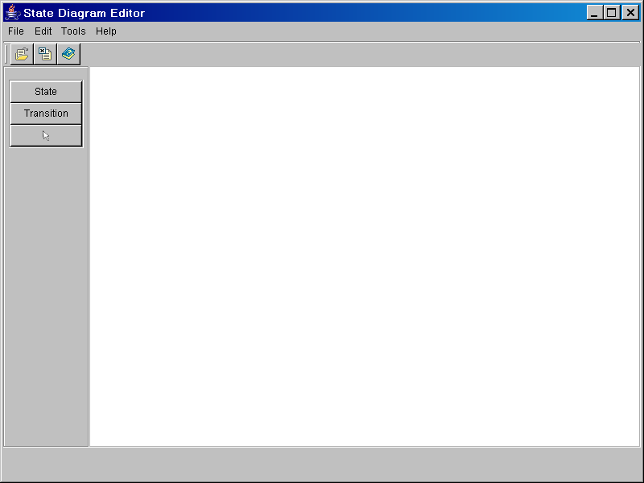
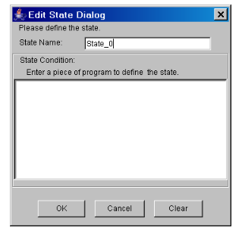
State Diagram Editor Behavior (partial)
add or delete a state or transition,
File->Save, File->Close [!saved]/display warning message
Editor Window w/a Blank Diagram
File->New Diagram
click State button, click canvas
File->Save As
Initial Editor Main Window
File->Close
Editor Window w/a State Diagram
Save State Diagram As Dialog
File->Open Diagram
locate diagram, OK
OK
OK or Cancel
State Diagram Selection Dialog
double-click a state or transition
Clear/clear all fields
Edit State/ Transition Dialog
12-<number>

Slide 19
Using Prototypes
Prototypes are useful for obtaining user feedback.
Types of prototypes
  Static approaches generate nonexecutable prototypes.
  Dynamic approaches generate executable prototypes.
  Hybrid approaches construct static prototypes during the initial stage of prototype development and switch to dynamic prototyping later.
12-<number>

Slide 20
Evaluating User Interfaces with Users (application of agile principles)
User interface presentation.
User interface demonstration.
User interface experiment.
User interface review meeting.
User interface survey.
12-<number>

Slide 21
User Support Capabilities
User support capabilities include online documentation, context-dependent help, error messages, and recovery.
Online help should let the user find the needed information easily.
Context-dependent help is a user-friendly design technique. Chain of responsibility supports this.
Error messages should be user-oriented, rather than developer-oriented, and be easy to understand.
12-<number>

Slide 22
Recover from Undesired State
Undo and redo operations (command pattern)
Automatic backup and restore system states (memento pattern)
Exception handling
Software fault tolerance
12-<number>

Slide 23
Guidelines for User Interface Design
User interface design should be user-centric.
The user interface should be consistent.
Minimize switching between mouse mode and keyboard mode.
A nice feature may not be that nice.
Eat your own cooking.
12-<number>

Slide 24
Applying Agile Principles
Active user involvement is imperative. A collaborative and cooperative approach between all stakeholders is essential.
Requirements evolve but the timescale is fixed.
Develop small, incremental releases and iterate. In addition, focus on frequent delivery of software products.
A good enough user interface design is enough. Value the working software over the design.
Capture requirements at a high level; lightweight and visual.
12-<number>

